Slide 1

DEEP CONVOLUTION NEURAL NETWORK FOR BIG DATA MEDICAL IMAGE CLASSIFICATION
By
NARALA SRINATH REDDY (21091F0050)
Under the esteemed guidance of
Ms. B. SWETHA _{M.Tech.,(Ph.D.)}
Assistant Professor
DEPARTMENT OF COMPUTER SCIENCE AND ENGINEERING
RAJEEV GANDHI MEMORIAL COLLEGE OF ENGINEERING & TECHNOLOGY
(AUTONOMOUS)
NANDYAL-518501, (Estd-1995)

Slide 2
Index
Abstract
Introduction
Literature review
Existing System
Disadvantages
Proposed system
Advantages
Methodology and algorithms
Modules
Feasibility study
Hardware and Software Requirements

Slide 3
Abstract:
Deep learning is one of the most unexpected machine learning techniques which is being used in many applications like image classiﬁcation, image analysis, clinical archives and object recognition.
With an extensive utilization of digital images as information in the hospitals, the archives of medical images are growing exponentially.
Digital images play a vigorous role in predicting the patient disease intensity and there are vast applications of medical images in diagnosis and investigation.
Due to recent developments in imaging technology, classifying medical images in an automatic way is an open research problem for researchers of computer vision.
For classifying the medical images according to their relevant classes a most suitable classiﬁer is most important. Where we are proposing our model where the algorithm is trained for classifying medical images by deep learning technique.
A pre-trained deep convolution neural network (GoogleNet) is used that which can classifies the various medical images for various body organs. This method of image classiﬁcation is beneﬁcial to predict the appropriate class or category of unknown images. The results of the experiment exhibit that our method is best suited to classify various medical images.
Keywords: Medical image classiﬁcation, pre-trained DCNN, convolution neural network, deep learning

Slide 4
Introduction:
Image classification is the primary domain, in which deep neural networks play the most important role of medical image analysis.
The image classification accepts the given input images and produces output classification for identifying whether the disease is present or not. In our model we mainly classify the different types of organs and predict the accuracy.
One of the most imperative problems faced in the domain area of image recognition is the classification of medical images.
The major intention of medical image classification is to classify medical images into several elements to assist medical practitioners or physicists in diagnosing disease.

Slide 5
Hence, medical image classification is split into two steps. The first and foremost step of medical image classification is to extract the essential features from the acquired input image.
The second step in medical image classification is utilizing the features to construct models that classify the image data set.
In the recent past, medical practitioners customarily utilized their specialized experience to extract features so that classification of medical images could be performed into several classes. However, this manual medical image classification was found to be highly cumbersome and time consuming.

Slide 6
Literature Review:
S. No | Journal Type with year | Authors | Title | Outcomes
1 | ’’ IEEE Trans. Med. Imag., vol. 39, no. 3, pp. 753–763, Mar. 2020 | Q. Zhu, B. Du, and P. Yan | Boundary-weighted domain adaptive neural network for prostate MR image segmentation | MR image segmentation using neural network
2 | Neuro computing, vol. 294, pp. 19–28, Jun. 2018 | Q.Zhu, B.Du, P.Yan, H.Lu, and L.Zhang | Shape prior constrained PSO model for bladder wall MRI segmentation | Bladder wall MRI segmentation using PSO model
3 | Complexity, vol. 2018, pp. 1–10, Feb. 2018 | Q. Zhu, B. Du, B. Turkbey, P. Choyke, and P. Yan | Exploiting inter slice correlation for MRI prostate image segmentation, from recursive neural networks aspect | MRI prostate image segmentation, from recursive neural networks aspect
4 | in Proc. Int. Conf. Circuits, Power Comput. Technol. (ICCPCT), Mar. 2014, pp. 1437–1442 | K.Kranthi Kumar and T.V.Gopal | A novel approach to self-order feature reweighting in CBIR to reduce semantic gap using relevance feedback | Reducing semantic gap using relevance feedback in CBIR

Slide 7
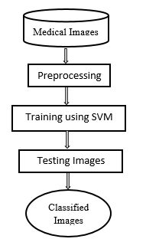
Existing System:
This model emphasizes an existing method that which is designed using the machine learning architecture which is used to classify the various medical images.
With an extensive utilization of digital images as information in the hospitals, the archives of medical images are growing exponentially. Digital images play a vigorous role in predicting the patient disease intensity and there are vast applications of medical images in diagnosis and investigation.
To make this in the easier way Support Vector Machine (SVM) is used that which can classifies the various medical images for various body organs. The block diagram of the existing method is shown in the below figure.
Block Diagram of Existing system

Slide 8
Disadvantages in Existing System:
Low efficiency.
Time consuming.
High complexities.
No accurate classification

Slide 9
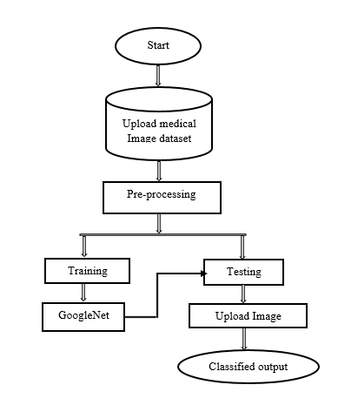
Proposed system:
The proposed model emphasizes a deep network architecture which is used to classify the various medical images. With an extensive utilization of digital images as information in the hospitals, the archives of medical images are growing exponentially.
Digital images play a vigorous role in predicting the patient disease intensity and there are vast applications of medical images in diagnosis and investigation.
Hence, we are proposing our model where the algorithm is trained for classifying medical images by deep learning technique. A pre-trained deep convolution neural network (GoogleNet) is used that which can classifies the various medical images for various body organs. The block diagram of the proposed model is shown in the below figure.
Block Diagram of Proposed system

Slide 10
Advantages of Proposed system:
High efficiency.
Time Saving.
Inexpensive.
Low complexities.

Slide 11
METHODOLOGY AND ALGORITHMS:
CNN:
A convolutional neural network consists of an input layer, hidden layers and an output layer. In any feed-forward neural network, any middle layers are called hidden because their inputs and outputs are masked by the activation function and final convolution.
Convolutional Layers
n a CNN, the input is a tensor with a shape: (number of inputs) x (input height) x (input width) x (input channels). After passing through a convolutional layer, the image becomes abstracted to a feature map, also called an activation map, with shape: (number of inputs) x (feature map height) x (feature map width) x (feature map channels).

Slide 12
Pooling layers:
Convolutional networks may include local and/or global pooling layers along with traditional convolutional layers. Pooling layers reduce the dimensions of data by combining the outputs of neuron clusters at one layer into a single neuron in the next layer. Local pooling combines small clusters, tiling sizes such as 2 x 2 are commonly used. Global pooling acts on all the neurons of the feature map. There are two common types of pooling in popular use: max and average. Max pooling uses the maximum value of each local cluster of neurons in the feature map, while average pooling takes the average value.

Slide 13
FEASIBILITY STUDY
The feasibility of the project is analysed in this phase and business proposal is put forth with a very general plan for the project and some cost estimates. During system analysis the feasibility study of the proposed system is to be carried out. This is to ensure that the proposed system is not a burden to the company. For feasibility analysis, some understanding of the major requirements for the system is essential.
Three key considerations involved in the feasibility analysis are
Economical Feasibility
Technical Feasibility
Social Feasibility

Slide 14
Economic feasibility:
This study is carried out to check the economic impact that the system will have on the organization. The amount of fund that the company can pour into the research and development of the system is limited.
Technical feasibility:
This study is carried out to check the technical feasibility, that is, the technical requirements of the system. Any system developed must not have a high demand on the available technical resources. The aspect of study is to check the level of acceptance of the system by the user.
Social feasibility:
The aspect of study is to check the level of acceptance of the system by the user. This includes the process of training the user to use the system efficiently. The user must not feel threatened by the system, instead must accept it as a necessity. The level of acceptance by the users solely depends on the methods that are employed to educate the user about the system and to make him familiar with it.

Slide 15
MODULES
1.System Module:
Create Dataset:
The dataset containing images of the desired objects to be recognize is split into training and testing dataset with the test size of 20-30%.
Pre-processing:
Resizing and reshaping the images into appropriate format to train our model.
Training:
Use the pre-processed training dataset is used to train our model using CNN algorithm.

Slide 16
2. User:
Register: The user needs to register and the data stored in MySQL database.
Login: A registered user can login using the valid credentials to the website to use a application.
About-Project: In this application, we have successfully created an application which takes to classify the images.
Upload Image: The user has to upload an image which needs to be classify the images.
Prediction: The results of our model is displayed as either Rice Blast, Leaf Blight, Healthy & Brown Spot.
Logout: Once the prediction is over, the user can logout of the application.

Slide 17
ACTIVITY DIAGRAM

Slide 18
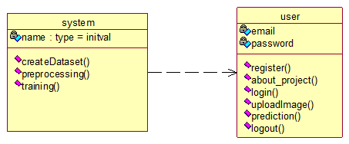
CLASS DIAGRAM
In software engineering, a class diagram in the Unified Modeling Language (UML) is a type of static structure diagram that describes the structure of a system by showing the system's classes, their attributes, operations (or methods), and the relationships among the classes. It explains which class contains information.

Slide 19
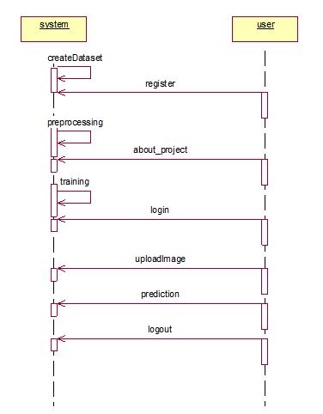
SEQUENCE DIAGRAM
A sequence diagram in Unified Modeling Language (UML) is a kind of interaction diagram that shows how processes operate with one another and in what order. It is a construct of a Message Sequence Chart. Sequence diagrams are sometimes called event diagrams, event scenarios, and time diagrams.

Slide 20
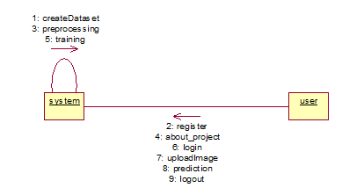
COLLABRATION DIAGRAM
In collaboration diagram the method call sequence is indicated by some numbering technique as shown below. The number indicates how the methods are called one after another. We have taken the same order management system to describe the collaboration diagram. The method calls are similar to that of a sequence diagram..

Slide 21
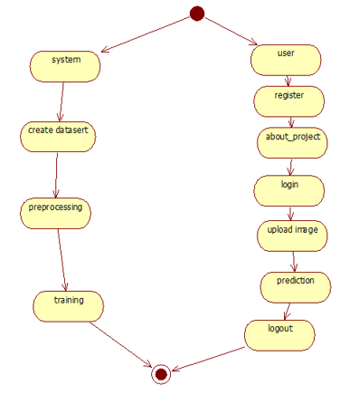
ACTIVITY DIAGRAM
Activity diagrams are graphical representations of workflows of stepwise activities and actions with support for choice, iteration and concurrency. In the Unified Modelling Language, activity diagrams can be used to describe the business and operational step-by-step workflows of components in a system. An activity diagram shows the overall flow of control.

Slide 22
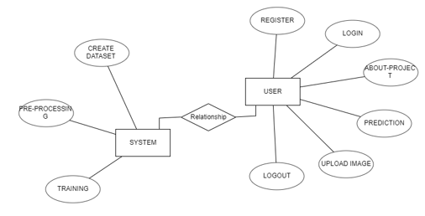
ER DIAGRAM

Slide 23
Hardware & Software Requirements:
H/W Configuration:
• Processor - I3/Intel Processor
• Hard Disk -160GB
• RAM - 8Gb
S/W Configuration:
• Operating System : Windows 7/8/10 .
• Server side Script : HTML, CSS & JS.
• IDE : Pycharm.
• Libraries Used : Numpy, IO, OS, Flask, keras.
• Technology : Python 3.6+

Slide 24
THANK YOU

